Slide 1
The jQuery JavaScript Library
Part I: Ajax Support
(jQuery 1.3 Version)
More jQuery tutorials and downloadable source code for these examples:
http://courses.coreservlets.com/Course-Materials/jquery.html

Slide 2
Topics
Overview of jQuery
Installation and documentation
Quick summary of jQuery selectors
Data centric Ajax: the “$.ajax” function
  Basics
  Options
  Sending data
Content-centric Ajax: the “load” function
Handling JSON data
Comparing Ajax support to other libraries
  Prototype, Dojo, Ext-JS

Slide 3
Introduction

Slide 4
Overview of jQuery
Ajax utilities (this tutorial)
  General: $.ajax(…), $(…).load(…)
  Shortcuts: $.get, $.post, $.getJSON
DOM search and manipulation utilities
  $("p.myStyle").addClass("extraStyle").show();
Simple animation
  Not as extensive as Scriptaculous, but easy to use
Cross-browser event model
  Assign handlers programmatically, hides browser differences
General JavaScript utilities
  Functions operating on strings and arrays
Rich GUIs
  jQuery UI provides widgets, fancier effects, drag/drop

Slide 5
Ajax Utilities
$.ajax({options})
  Makes an Ajax request. Example:
    $.ajax({ url: "address", success: responseHandler});
    The response handler is passed the response text, not the response object. Don’t forget the “.” before “ajax”!
load(url)
  Makes Ajax request and loads result into HTML element
    $("#some-id").load("address");
    A data string or object is an optional second arg
Shortcuts
  $.get, $.post, $.getJSON
    Slightly simpler forms of $.ajax. However, as of jQuery 1.3, they take data objects but not data strings, so you can’t use “serialize”. So, $.ajax is better.

Slide 6
Downloading and Installation
Download
  http://docs.jquery.com/Downloading_jQuery
    Download single minimized file (e.g., jquery-1.3.2.min.js)
      Recommend renaming to jquery.js to simplify later upgrades
Online API and tutorials
  http://docs.jquery.com/
Browser Compatibility
  Firefox: 2 or later (vs. 1.5 or later for Prototype)
  Internet Explorer: 6.0 or later (does not work in IE 5.5)
  Safari: 3.0 or later (vs. 2.0 or later for Prototype)
  Opera: 9.0 or later (vs. 9.25 or later for Prototype)
  Chrome: 1.0 or later
  To check, run the test suite at http://jquery.com/test/

Slide 7
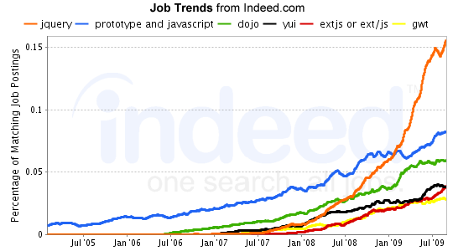
Industry Usage
Approximately 40% of matches to “prototype and JavaScript” were false positives such as “build a prototype with JavaScript”. So, discount the Prototype graph by about 40%.

Slide 8
jQuery Selectors: Basics
Note: brief intro only. More details in online tutorial at http://courses.coreservlets.com/Course-Materials/jquery.html.

Slide 9
Selecting DOM Elements
Idea
  Use $("css selector") to get a set of DOM elements
    Then, perform operations on each (see next page)
    Much more detail given in next tutorial section
Examples
  $("#some-id")
    Return 1-element set (or empty set) of element with id
    Simplest use, and most common for Ajax (note the “#”!)
  $("p")
    Return all p elements
  $(".blah")
    Return all elements that have class="blah"
  $("li b span.blah")
    Return all <span class="blah"> elements that are inside b elements, that in turn are inside li elements

Slide 10
Manipulating DOM Elements
Common functions on matched elements
  $("#some-id").val()
    Returns value of input element. Used on 1-element sets.
  $("selector").each(function)
    Calls function on each element. “this” set to element.
  $("selector").addClass("name")
    Adds CSS class name to each. Also removeClass, toggleClass
  $("selector").hide()
    Makes invisible (display: none). Also show, fadeOut, fadeIn, etc.
  $("selector").click(function)
    Adds onclick handler. Also change, focus, mouseover, etc.
  $("selector").html("<tag>some html</tag>")
    Sets the innerHTML of each element. Also append, prepend
Chaining
  $("a").click(funct1).addClass("name").each(funct2)

Slide 11
Example: Randomizing Background Colors (JavaScript)
function randomizeHeadings() {
$("h3").each(setRandomStyle);
$("h3.green").hide("slow");
}
function setRandomStyle() {
$(this).addClass(randomStyle());
}
function randomStyle() {
var styles = ["red", "yellow", "green"];
return(randomElement(styles));
}
function randomElement(array) {
var index = Math.floor(Math.random()*array.length);
return(array[index]);
}
Call setRandomStyle function on each h3 element
Slowly hide every h3 that has CSS style “green”
Add “red”, “yellow” or “green” CSS names to each

Slide 12
Example: Randomizing Colors (JavaScript Continued)
function revertHeadings() {
$("h3.green").show("slow");
$("h3").removeClass("red").removeClass("yellow")
.removeClass("green");
}
$(function() {
$("#button1").click(randomizeHeadings);
$("#button2").click(revertHeadings);
});
Like smart window.onload. Explained in next section.
Sets onclick handlers

Slide 13
Example: Randomizing Colors (Style Sheet)
.red { background-color: red }
.yellow { background-color: yellow }
.green { background-color: green }
…
Names set by setRandomStyles function

Slide 14
Example: Randomizing Colors (HTML)
…
<head><title>jQuery Basics</title>
<link rel="stylesheet"
href="./css/styles.css"
type="text/css"/>
<script src="./scripts/jquery.js"
type="text/javascript"></script>
<script src="./scripts/jquery-basics.js"
type="text/javascript"></script>
</head>
Renamed from jquery-1.3.2.min.js

Slide 15
Example: Randomizing Colors (HTML Continued)
…
<h3>Foo, bar, baz</h3>
<h3>Blah, blah, blah</h3>
<h3>Yadda, yadda, yadda</h3>
<h3>Foo, bar, baz</h3>
<h3>Blah, blah, blah</h3>
<h3>Yadda, yadda, yadda</h3>
<h3>Foo, bar, baz</h3>
<h3>Blah, blah, blah</h3>
<h3>Yadda, yadda, yadda</h3>
<form action="#">
<input type="button" id="button1"
value="Randomize Headings"/>
<input type="button" id="button2"
value="Revert Headings"/>
</form> …
The ids to which click handlers were attached.

Slide 16
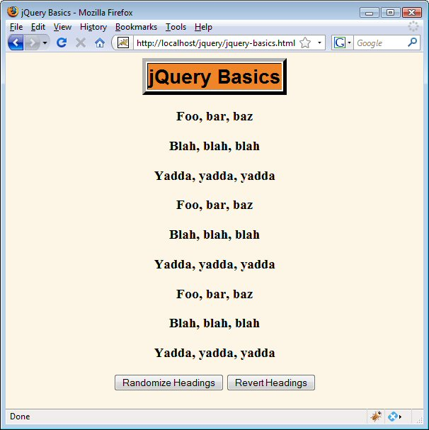
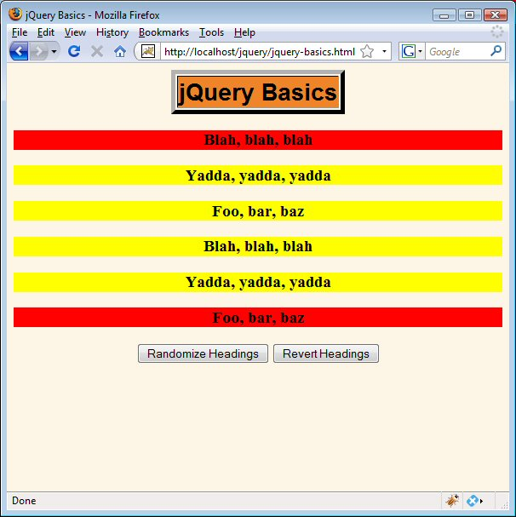
Example: Randomizing Colors (Results)
After “Randomize Headings”. Some headings turned green, then gradually disappeared.
When page originally loaded, or after “Revert Headings”

Slide 17
$.ajax: Basics

Slide 18
$.ajax: Basic Syntax
$.ajax(optionsObject)
  Minimal form: $.ajax({url: "address", success: funct});
    Don’t forget the “.”. It is $.ajax(…), not $ajax(…).
  The handler function gets the response text, not the response object. jQuery figures out if it should be plain text or XML from the response type. If you want the handler to get JSON, use dataType option
Options for $.ajax({…})
  Almost-always used
    url, success
  Other common options
    cache, data, dataType, error, type, username, password

Slide 19
Data-Centric Ajax with and without Toolkits
With basic JavaScript
  function getRequestObject() {
  if (window.XMLHttpRequest) {
  return(new XMLHttpRequest());
  } else if (window.ActiveXObject) {
  return(new ActiveXObject("Microsoft.XMLHTTP"));
  } else { return(null); }
  }
  function sendRequest() {
  var request = getRequestObject();
  request.onreadystatechange =
  function() { someFunct(request); };
  request.open("GET", "some-url", true);
  request.send(null);
  }

Slide 20
Data-Centric Ajax with and without Toolkits
jQuery (handler passed response text)
  $.ajax({url: "address",
  success: handlerFunct});
Prototype (handler passed response object)
  new Ajax.Request("address",
  {onSuccess: handlerFunct});
Ext (handler passed response object)
  Ext.Ajax.request({url: "address",
  success: handlerFunct});
Dojo (handler passed response text)
  dojo.xhrGet({url: "address",
  load: handlerFunct});

Slide 21
$.ajax Example Code:
JavaScript
function showTime1() {
$.ajax({ url: "show-time.jsp",
success: showAlert,
cache: false });
}
function showAlert(text) {
alert(text);
}
The cache option is not required, but is a convenient option when the same URL (including query data) yields different responses. This way, you don’t have to send Cache-Control and Pragma headers from server.
This is the response text, not the response object (XmlHttpRequest). Also note that the latest Firefox does not let you pass native functions here, so you cannot use alert instead of showAlert for the success parameter.

Slide 22
$.ajax Example Code:
HTML
...
<head><title>jQuery and Ajax</title>...
<script src="./scripts/jquery.js"
type="text/javascript"></script>
<script src="./scripts/jquery-ajax.js"
type="text/javascript"></script>
</head>
<body>...
<fieldset>
<legend>$.ajax: Basics (Using onclick
handler in HTML)</legend>
<form action="#">
<input type="button" value="Show Time"
onclick='showTime1()'/>
</form>
</fieldset>

Slide 23
$.ajax Example Code:
JSP
It is now <%= new java.util.Date() %>

Slide 24
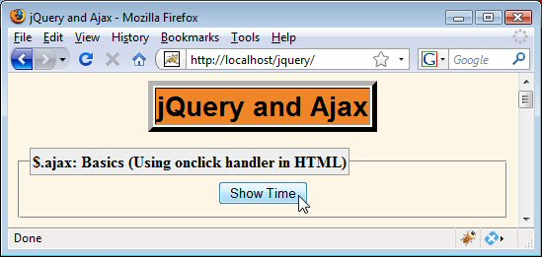
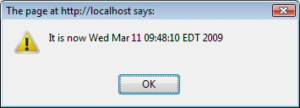
$.ajax: Results

Slide 25
Registering Event Handlers in JavaScript
Basic approach
  Previous example set the onclick handler in the HTML. Although this is common with some Ajax libraries, jQuery advocates setting it in the JavaScript instead
    Often referred to as “unobtrusive JavaScript”: no explicit JavaScript anywhere in the HTML page
jQuery support
  $(function() {…});
    Function runs after the DOM is loaded, but does not wait for images, as with window.onload
    Use this approach to set up all event handlers
  $("#some-id").click(someHandler);
    Assigns to onclick handler. Handler is passed an Event object with characteristics that are unified across browsers

Slide 26
Redoing Time Alert: JavaScript
$(function() {
$("#time-button-1").click(showTime1);
});
function showTime1() {
$.ajax({ url: "show-time.jsp",
success: showAlert,
cache: false });
}
function showAlert(text) {
alert(text);
}
These two functions are unchanged from previous example.

Slide 27
Redoing Time Alert: HTML
<fieldset>
<legend>$.ajax: Basics (Using click
function in JavaScript)</legend>
<form action="#">
<input type="button" value="Show Time"
id='time-button-1'/>
</form>
</fieldset>

Slide 28
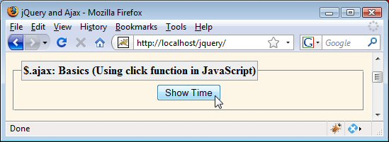
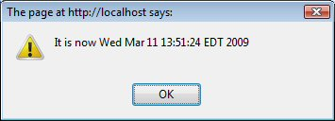
Redoing Time Alert: Results
Works exactly the same as previous example.

Slide 29
$.ajax:
Sending Data

Slide 30
Overview
$.ajax({ url: …, success: …, data: …});
  Can be a String, in which case it is sent unchanged.
    On end of URL or in POST data, depending on HTTP type
    See later example for building the string automatically using the “serialize” function
  Can be an object, in which case query string gets built out of property names and URL-encoded property values
    Works identically to “parameters” option in Prototype
Equivalent examples
  $.ajax({… data: "param1=foo+bar%21&param2=baz"});
  $.ajax({… data: { param1: "foo bar!", param2: "baz"}});

Slide 31
Data Example: JavaScript
$(function() {
$("#params-button-1").click(showParams1);
…
});
function showAlert(text) {
alert(text);
}
function showParams1() {
$.ajax({ url: "show-params.jsp",
data: "param1=foo&param2=bar",
success: showAlert });
}
Same function used in earlier examples.
The cache option is not used since the same data always results in the same response.

Slide 32
Data Example: HTML
…
<fieldset>
<legend>$.ajax: The 'data' Option</legend>
<form action="#">
<input type="button" value="Show Params"
id='params-button-1'/>
</form>
</fieldset>

Slide 33
Data Example: JSP
param1 is ${param.param1},
param2 is ${param.param2}.

Slide 34
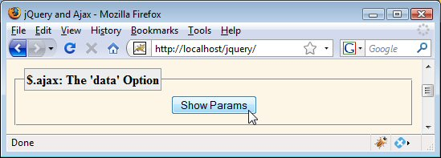
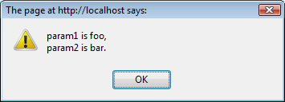
Data Example: Results

Slide 35
$.ajax:
Options and Shortcuts

Slide 36
Overview
Options (almost) always used: url, success
  $.ajax({url: "some-address", success: someFunction});
    success is not strictly required; you might want to just fire off some data to the server and not display anything
Common options: example
  $.ajax({
  url: "address",
  success: successHandlerFunction,
  data: { param1: "foo bar", param2: "baz"},
  error: errorHandlerFunction,
  cache: false,
  dataType: "json",
  username: "resig",
  password: "scriptaculous-fan" });

Slide 37
Options
Name | Description | Default
async | Should the request be asynchronous? Use synchronous requests with caution since they lock up the browser. | true
beforeSend | Function to modify XMLHttpRequest object before it is sent (e.g., to set custom headers). The XHR is automatically passed to function. | None
cache | Is browser permitted to cache the page? Set to false if you use GET and you could get different responses back from the same data. Equivalent to having the server send Cache-Control: no-cache and Pragma: no-cache. | true (except false if dataType is script or json)
complete | Function to be called after error or success function is finished. | None
contentType | Content-Type of data sent to server. Rarely needed. | application/ x-www-form-urlencoded
data | Data to send to server (possibly after conversion). Sent in the appropriate place depending on whether it is GET or POST. Can be a String or an object. If a String, sent unchanged. If an object, property names become param names and property values get URL-encoded and become param values. & and = inserted automatically. | Empty

Slide 38
Options (Continued)
Name | Description | Default
dataFilter | Response-data sanitizing function. Rarely used. | None
dataType | The format in which to pass the response to the handler function. Legal values are text, html (same as text except embedded scripts are run), xml, json, jsonp (JSON with Padding), and script (evaluates the response as JavaScript and returns it as plain text). | html or xml (makes intelligent guess)
error | Function to be called if request fails. Function is passed 3 args: the XHR object, a string describing the error type, and an optional exception object. Possible values for the second argument are null, "timeout", "error", "notmodified" and "parsererror". | None
global | jQuery lets you set global defaults for various handlers: should they be used if set? | true
ifModified | Should the request be considered successful only if the response has changed since the last request (based on the Last-Modified header)? | false
jsonp | Override the callback function name in a jsonp request. JSONP is a JSON extension in which the name of a callback function is specified as an input argument of the call itself. | callback
password username | Username and password to be used in response to HTTP authentication request. | None

Slide 39
Options (Continued)
Name | Description | Default
processData | Should the value of the “data” property, if an object, be turned into a URL-encoded query string? | true
scriptCharset | Forces the request to be interpreted as a certain charset. Only for requests with dataType of “jsonp” or “script” and type of “GET”. | None
success | Function to be called if request succeeds. Function gets passed 2 args: the data returned from the server (formatted according to the dataType property), and a string describing the status. | None
timeout | Timeout in milliseconds. If request takes longer, the error handler will be called instead of the success handler. | Global timeout, if set via $.ajaxSetup
type | The HTTP method to use for the request. “get” and “post” are main options, but some browsers support other methods. | get
url | The address to request. Should be a relative URL. | None
xhr | Callback for creating your own custom XMLHttpRequest object. | ActiveXObject if available (IE), XMLHttpRequest otherwise

Slide 40
Shortcuts for $.ajax:
Equivalent Forms
$.get
  $.get("url", dataObj, someFunct)
  $.ajax({url: "url", data: dataObj, success: someFunct});
$.post
  $.post("url", dataObj, someFunct)
  $.ajax({url: "url", data: dataObj, success: someFunct,
  type: "post"});
$.getJSON
  $.get("url", dataObj, someFunct)
  $.ajax({url: "url", data: dataObj, success: someFunct,
  dataType: "json"});
Note
  get and post take the type as an optional fourth argument

Slide 41
Pros and Cons of Shortcuts
Advantages of shorthand functions
  Slightly shorter and (arguably) clearer
Disadvantages of shorthand functions
  The data cannot be a string. This means you cannot use the serialize function (discussed later) to automatically build the query string from the form
  If you want additional options later, you have to change existing code more drastically
  If you don’t have data, you have to pass in null. This is less convenient than just omitting the “data” property.
    $.get("url", null, someHandler); vs.
    $.ajax({url: "url", success: someHandler});

Slide 42
Simplifying Inserting Results into HTML: the “load” Function

Slide 43
load: Basic Syntax
Basic forms
  $("#result-area-id").load("url");
  $("#result-area-id").load("url", data);
  $("#result-area-id").load("url", data, handlerFunction);
Helper utilities
  val: reading the value of an input element
    var text = $("#some-textfield-id").val();
    Works for all input elements, even multiselectable select elements (in which case it returns an array)
  Filtering returned HTML
    Add jQuery selectors to the URL. Only elements that match will be inserted. E.g., to insert only li elements:
      $("#result-id").load("address li");
      Go very light with filtering: use data-centric Ajax instead.

Slide 44
Content-Centric Ajax with and without Toolkits (Basic JS Only)
function getRequestObject() { ... }
function ajaxResult(address, resultRegion) {
var request = getRequestObject();
request.onreadystatechange =
function() { showResponseText(request,
resultRegion); };
request.open("GET", address, true);
request.send(null);
}
function showResponseText(request, resultRegion) {
if ((request.readyState == 4) &&
(request.status == 200)) {
document.getElementById(resultRegion).innerHTML =
request.responseText;
}
}

Slide 45
Content-Centric Ajax with and without Toolkits ($.ajax)
function ajaxResult(address, resultRegion) {
$.ajax({
url: address,
success: function(text) {
showResponseText(text, resultRegion);
}
});
}
function showResponseText(text, resultRegion) {
$(resultRegion).html(text);
}
Note: use the “html” function (as above) to replace the innerHTML of the element. Use “append” to add to the end of the innerHTML of the element.

Slide 46
Content-Centric Ajax with and without Toolkits (Libraries)
jQuery
  function ajaxResult(address, resultRegion) {
  $(resultRegion).load(address);
  }
Prototype
  function ajaxResult(address, resultRegion) {
  new Ajax.Updater(resultRegion, address);
  }
Dojo
  No explicit support for content-centric Ajax
Ext-JS
  function ajaxResult(address, resultRegion) {
  Ext.get(resultRegion).load({ url: address});
  }

Slide 47
load Example 1: JavaScript
$(function() {
$("#params-button-2").click(showParams2);
…
});
function showParams2() {
var params =
{ param1: $("#field1").val(),
param2: $("#field2").val() };
$("#result1").load("show-params.jsp", params);
}
field1 and field2 are textfield ids (not names)
id of div whose innerHTML will become the result text.

Slide 48
load Example 1: HTML
...
<fieldset>
<legend>$.load: Simplifying HTML Insertion</legend>
<form action="#">
param1:
<input type="text" id="field1"/>
<br/>
param2:
<input type="text" id="field2"/>
<br/>
<input type="button" value="Show Params"
id="params-button-2"/>
<h2 id="result1"></h2>
</form>
</fieldset>

Slide 49
load Example 1: JSP
param1 is ${param.param1},
param2 is ${param.param2}.
Unchanged from previous example

Slide 50
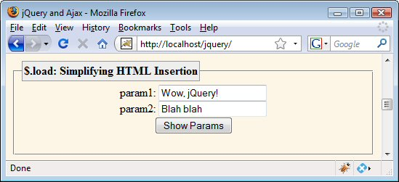
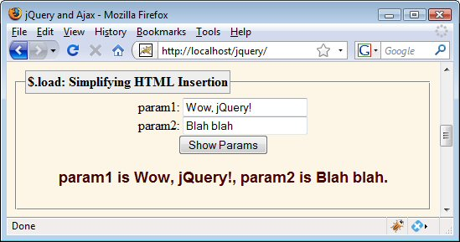
load Example 1: Results

Slide 51
Building Parameter Strings Automatically with “serialize”

Slide 52
Using “serialize”
Idea
  You specify a form, and jQuery automatically builds query string from all appropriate input elements.
  The element names (not ids) become the param names
Syntax
  $("result-id").load("url", $("#form-id").serialize());
Advantages
  One function call, no matter how many input elements
  Only takes values of active elements (e.g., unchecked radio buttons or checkboxes are ignored)
  Giving names to input elements is familiar to HTML developers

Slide 53
load Example 2: JavaScript
$(function() {
$("#params-button-3").click(showParams3);
…
});
function showParams3() {
$("#result2").load("show-params.jsp",
$("#form1").serialize());
}

Slide 54
load Example 2: HTML
...
<fieldset>
<legend>$.load: Simplifying Params with
'serialize'</legend>
<form action="#" id="form1">
param1:
<input type="text" name="param1"/>
<br/>
param2:
<input type="text" name="param2"/>
<br/>
<input type="button" value="Show Params"
id='params-button-3'/>
<h2 id="result2"></h2>
</form>
</fieldset>

Slide 55
load Example 2: JSP
param1 is ${param.param1},
param2 is ${param.param2}.
Unchanged from previous examples

Slide 56
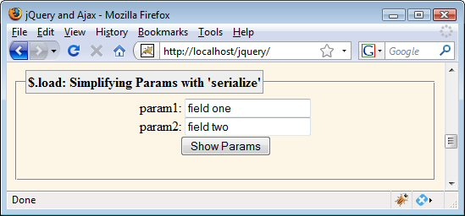
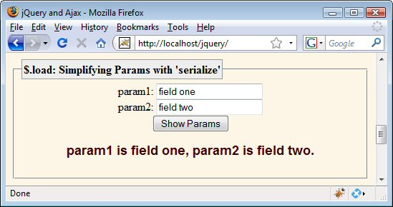
load Example 2: Results

Slide 57
Handling JSON Data

Slide 58
Approach
Server
  Returns JSON object with no extra parens. E.g.:
    { cto: "Resig ", ceo: "Gates ", coo: "Ellison" }
Code that calls $.ajax
  Specifies dataType of json. E.g.:
    $.ajax({ url: address, success: handler, dataType: "json" });
Response handler
  Receives JavaScript data as first argument. No need for parsing or “eval”. Must build HTML from result. E.g.:
    function handler(companyExecutives) {
    $("#some-id").html("<b>Chief Technology Officer is " +
    companyExecutives.cto + "</b>");
    }

Slide 59
JSON Example Code: Core JavaScript
$(function() { …
$("#nums-button").click(showNums);
});
function showNums() {
$.ajax({ url: "show-nums",
dataType: "json",
success: showNumberList });
}
function showNumberList(jsonData) {
var list = makeList(jsonData.fg, jsonData.bg,
jsonData.fontSize,
jsonData.numbers);
$("#result3").html(list);
}
Strings
int
Array of doubles

Slide 60
JSON Example Code: Auxiliary JavaScript
function makeList(fg, bg, fontSize, nums) {
return(
listStartTags(fg, bg, fontSize) +
listItems(nums) +
listEndTags());
}
function listStartTags(fg, bg, fontSize) {
return(
"<div style='color:" + fg + "; " +
"background-color:" + bg + "; " +
"font-size:" + fontSize + "px'>\n" +
"<ul>\n");
}

Slide 61
JSON Example Code: Auxiliary JavaScript (Continued)
function listItems(items) {
var result = "";
for(var i=0; i<items.length; i++) {
result = result + "<li>" + items[i] + "</li>\n";
}
return(result);
}
function listEndTags() {
return("</ul></div>");
}

Slide 62
JSON Example Code: HTML
<fieldset>
<legend>$.ajax: Treating Response as JSON</legend>
<form action="#">
<input type="button" value="Show Nums"
id='nums-button'/>
<div id="result3"></div>
</form>
</fieldset>

Slide 63
JSON Example Code: Servlet
public class ShowNumbers extends HttpServlet {
public void doGet(HttpServletRequest request,
HttpServletResponse response)
throws ServletException, IOException {
response.setHeader("Cache-Control", "no-cache");
response.setHeader("Pragma", "no-cache");
String fg = ColorUtils.randomColor();
request.setAttribute("fg", fg);
String bg = ColorUtils.randomColor();
request.setAttribute("bg", bg);
String fontSize = "" + (10 + ColorUtils.randomInt(30));
request.setAttribute("fontSize", fontSize);
double[] nums =
{ Math.random(), Math.random(), Math.random() };
request.setAttribute("nums", nums);
response.setContentType("application/json");
String outputPage = "/WEB-INF/results/show-nums.jsp";
RequestDispatcher dispatcher =
request.getRequestDispatcher(outputPage);
dispatcher.include(request, response);
}}

Slide 64
JSON Example Code: JSP
{ fg: "${fg}",
bg: "${bg}",
fontSize: ${fontSize},
numbers: [ ${nums[0]}, ${nums[1]}, ${nums[2]}]
}
Notes
  Client-side code does not need wrap in parens and pass to “eval”. JSON evaluation handled automatically by jQuery
  Types
    fg and bg: Strings
    fontSize: int
    numbers: Array of doubles

Slide 65
JSON Example Code: Auxiliary Java Code
public class ColorUtils {
private static String[] colors = {
"aqua", "black", "blue", "fuchsia", "gray",
"green", "lime", "maroon", "navy", "olive",
"purple", "red", "silver", "teal", "white", "yellow" };
/** One of the official HTML color names, at random. */
public static String randomColor() {
return(RandomUtils.randomElement(colors));
}
private ColorUtils() {} // Uninstantiatable class}
}

Slide 66
JSON Example Code: Auxiliary Java Code
public class RandomUtils {
private static Random r = new Random();
public static int randomInt(int range) {
return(r.nextInt(range));
}
public static int randomIndex(Object[] array) {
return(randomInt(array.length));
}
public static <T> T randomElement(T[] array) {
return(array[randomIndex(array)]);
}
}

Slide 67
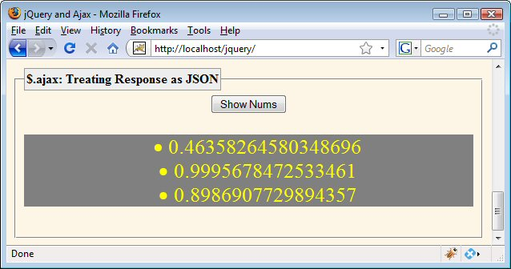
JSON Example: Results

Slide 68
Wrap-up

Slide 69
“Best” JavaScript Libraries
General JavaScript programming
  Prototype is clear leader
DOM manipulation
  jQuery is leader
    But others copying jQuery’s approach and closing the gap
      See http://sizzlejs.com/ -- jQuery’s selector library now separate
Rich GUIs
  Ext/JS, Dojo, and YUI are leaders
    jQuery UI: 2nd tier, Prototype: nothing, Scriptaculous: few
Usage in industry
  jQuery is clear leader as of late 2009
Looking ahead
  All entries above are likely to change significantly
  Google’s Closure Library lurking on the horizon!

Slide 70
Books and References
jQuery in Action
  by Bear Bibeault, Yehuda Katz, and John Resig
Learning jQuery 1.3
  by Jonathan Chaffer, Karl Swedberg, and John Resig
http://docs.jquery.com/
  Very complete
  Moderately well organized
  Moderate number of explicit examples
jQuery UI 1.6
  By Dan Wellman
  Looks good, but jQuery UI is changing rapidly (current version is 1.7), so the online docs are perhaps better

Slide 71
Summary
Assigning event handlers programmatically
  $(function() {
  $("#some-id").click(someFunction);
  });
General Ajax requests (data-centric Ajax)
  $.ajax({ url: "relative-address",
  success: handlerFunction,
  data: $("#form-id").serialize(),
  dataType: "json" });
Loading result (content-centric Ajax)
  $("#result-id").load("relative-address",
  $("#form-id").serialize());

Slide 72
Questions?
More jQuery tutorials and downloadable source code for these examples:
http://courses.coreservlets.com/Course-Materials/jquery.html

